Slide 1
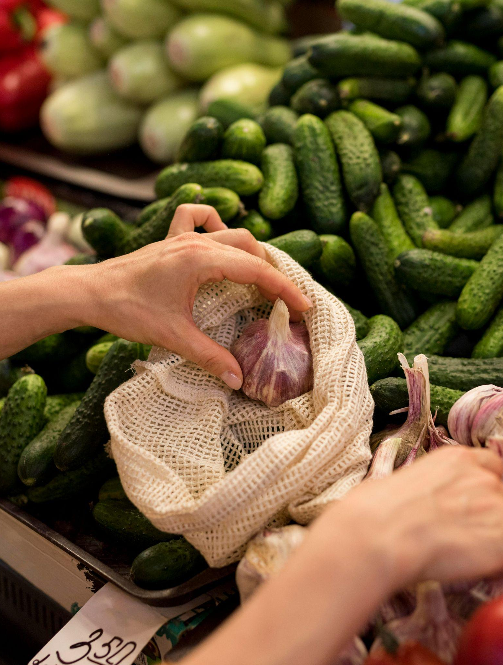
Daily Prices of Market Yard Commodities in Telangana
By.
K. JAYA KRISHNA

Slide 2
Contents of this template
Fonts | Figtree and Candal (table of contents text), System- ui (Headings(Green)), Menlo (text)
Colors(Graphs) | Prices(Sea green), Arrivals(Dodger blue), Bowenpally(Maroon red), Gaddiannaram (Orange), Gudumalkapur(Blue), Mahabubmansion(SkyBlue), Suryapet(grey), plasma(shade)

Slide 3
Table of contents
01
02
03
05
06
Back Story
Business Objective
Data Info
04
Approach
Visualizations
& Insights
Conclusion

Slide 4
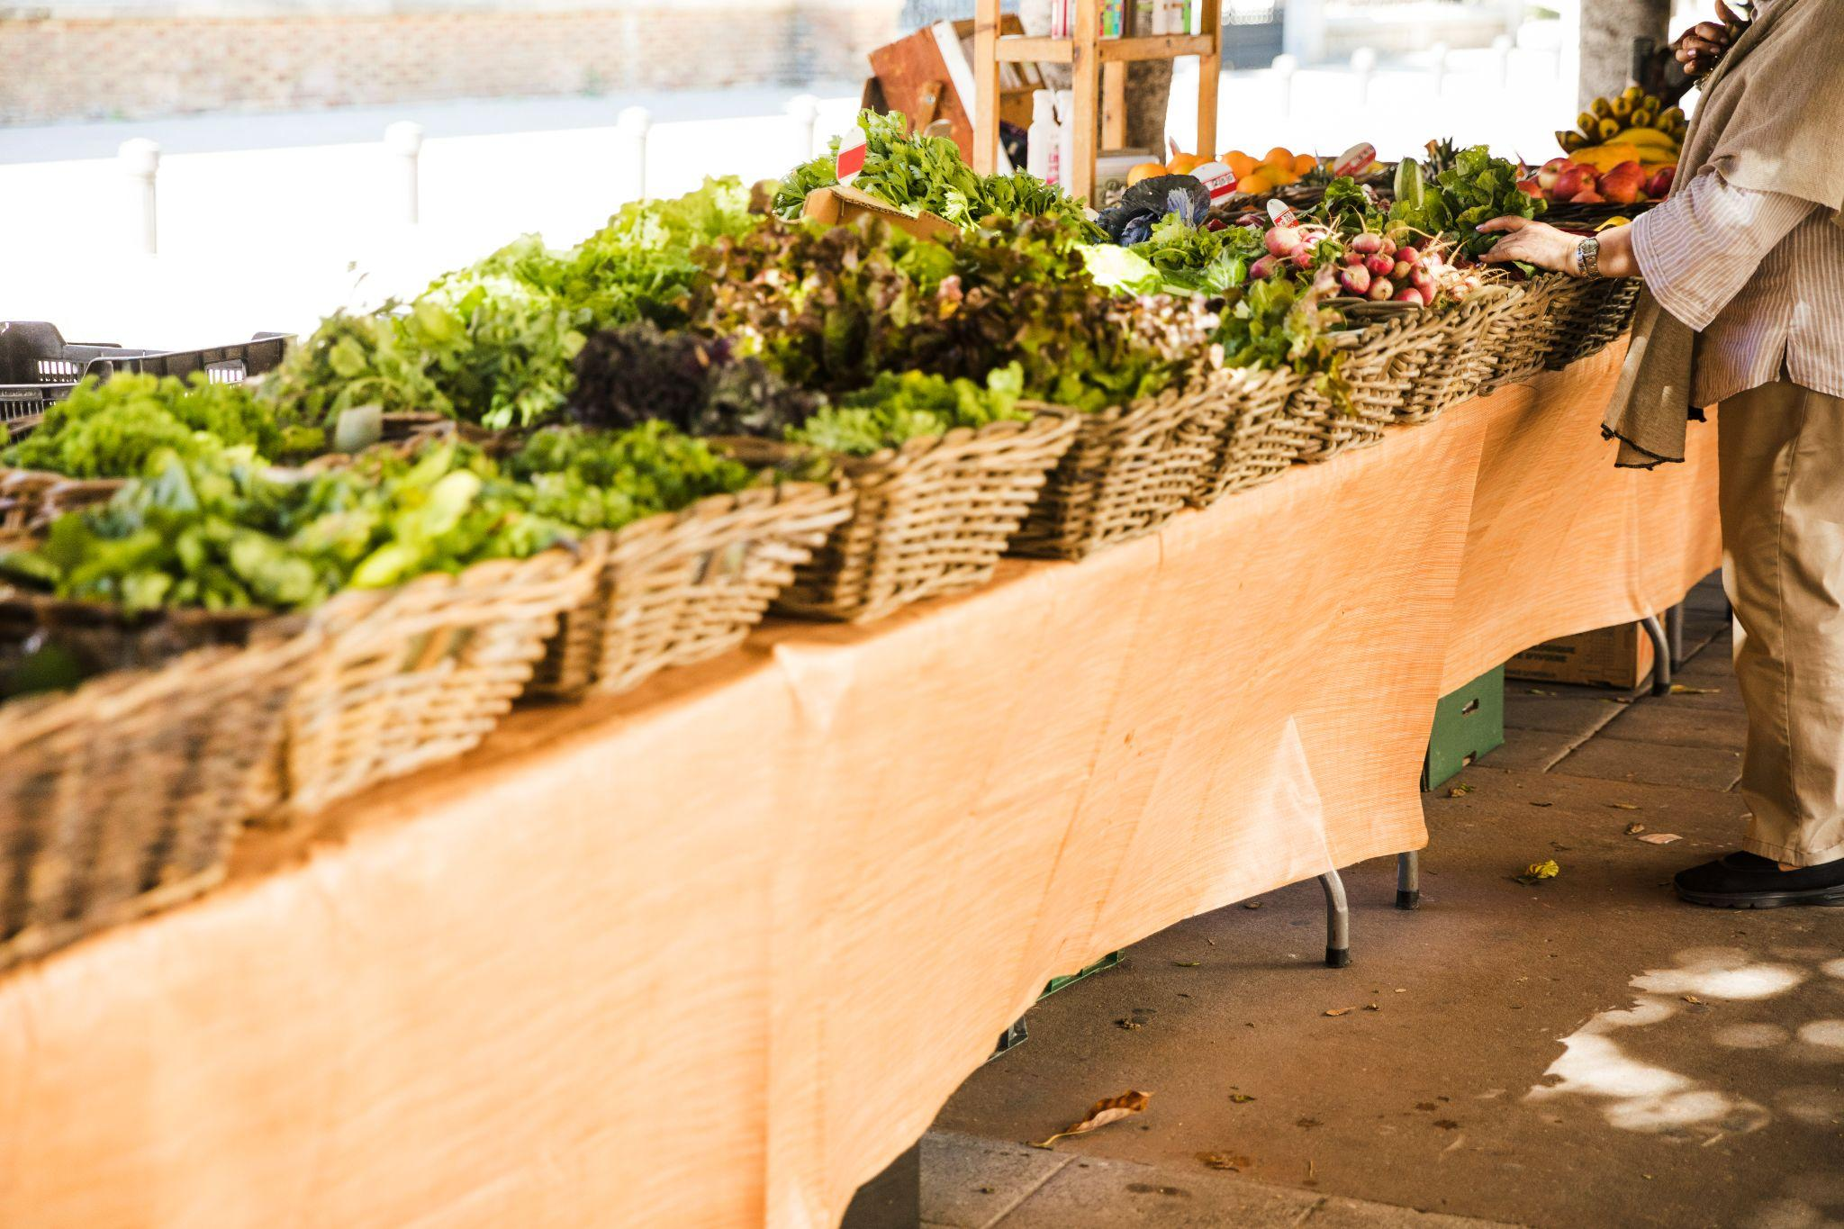
01
Back Story

Slide 5
Back Story :-
In 2023, while roaming in a Telangana market, I and my friend noticed a heated argument between a customer and a vendor over onion prices—50 INR/kg, a sharp rise from 30 INR. The vendor blamed supply shortages and lack of storage, while the customer struggled with affordability.
This incident, reflecting broader market issues like price volatility and infrastructure gaps, inspired you to join the Telangana Agricultural Board’s initiative.
Tasked with analyzing a 2021–2025 dataset of market arrivals, you aimed to identify top yards and commodities, using data to recommend solutions like better storage, ultimately improving market efficiency and fairness for all stakeholders.

Slide 6
02
Business Objective

Slide 7
Business Objective
The agricultural sector in Telangana faces challenges related to fluctuating commodity prices, which directly impact both farmers' income and consumer pricing.
By examining daily price data across multiple years (2021-2025) for a wide range of agricultural commodities, this analysis seeks to uncover significant trends, seasonal patterns, and periods of high volatility.

Slide 8
03
Data Info

Slide 9
Data Info
Agriculture Organisation : Agricultural Marketing and Co-operation Department
Data available from 01-01-2021 to 31-03-2025
This dataset contains information on the daily prices of all the commodities across all the market yards in the state of Telangana Contains the below columns: | DDate | AmcCode | AmcName | YardCode | YardName | CommCode | CommName | VarityCode | VarityName | Arrivals | Minimum | Maximum | Modal |
Abbreviation:
* DDate: Date
* AmcName: Agricultural Market Committee Name
* YardName: Agricultural Market Yard Name
* CommName: Commodity Name
* VarityName: Commodity Variety Name
* Arrivals: Quantity in Quintals (Qtls)
* Minimum: Minimum Price per Quintal
* Maximum: Maximum Price per Quintal
* Modal: Modal Price is the price per quintal at which most transactions took place

Slide 10
04
Approach

Slide 11
Approach :
Removes time from the column :
dff['DDate']=dff['DDate'].str.split(" ").apply(lambda x:x[0])
Converts object type column to date type
dff["DDate"] = pd.to_datetime(dff["DDate"])
Adds new column revenue
dff["Revenue"] = dff['Arrivals']*dff['Model’]

Slide 12
05
Visualizations & Insights

Slide 13
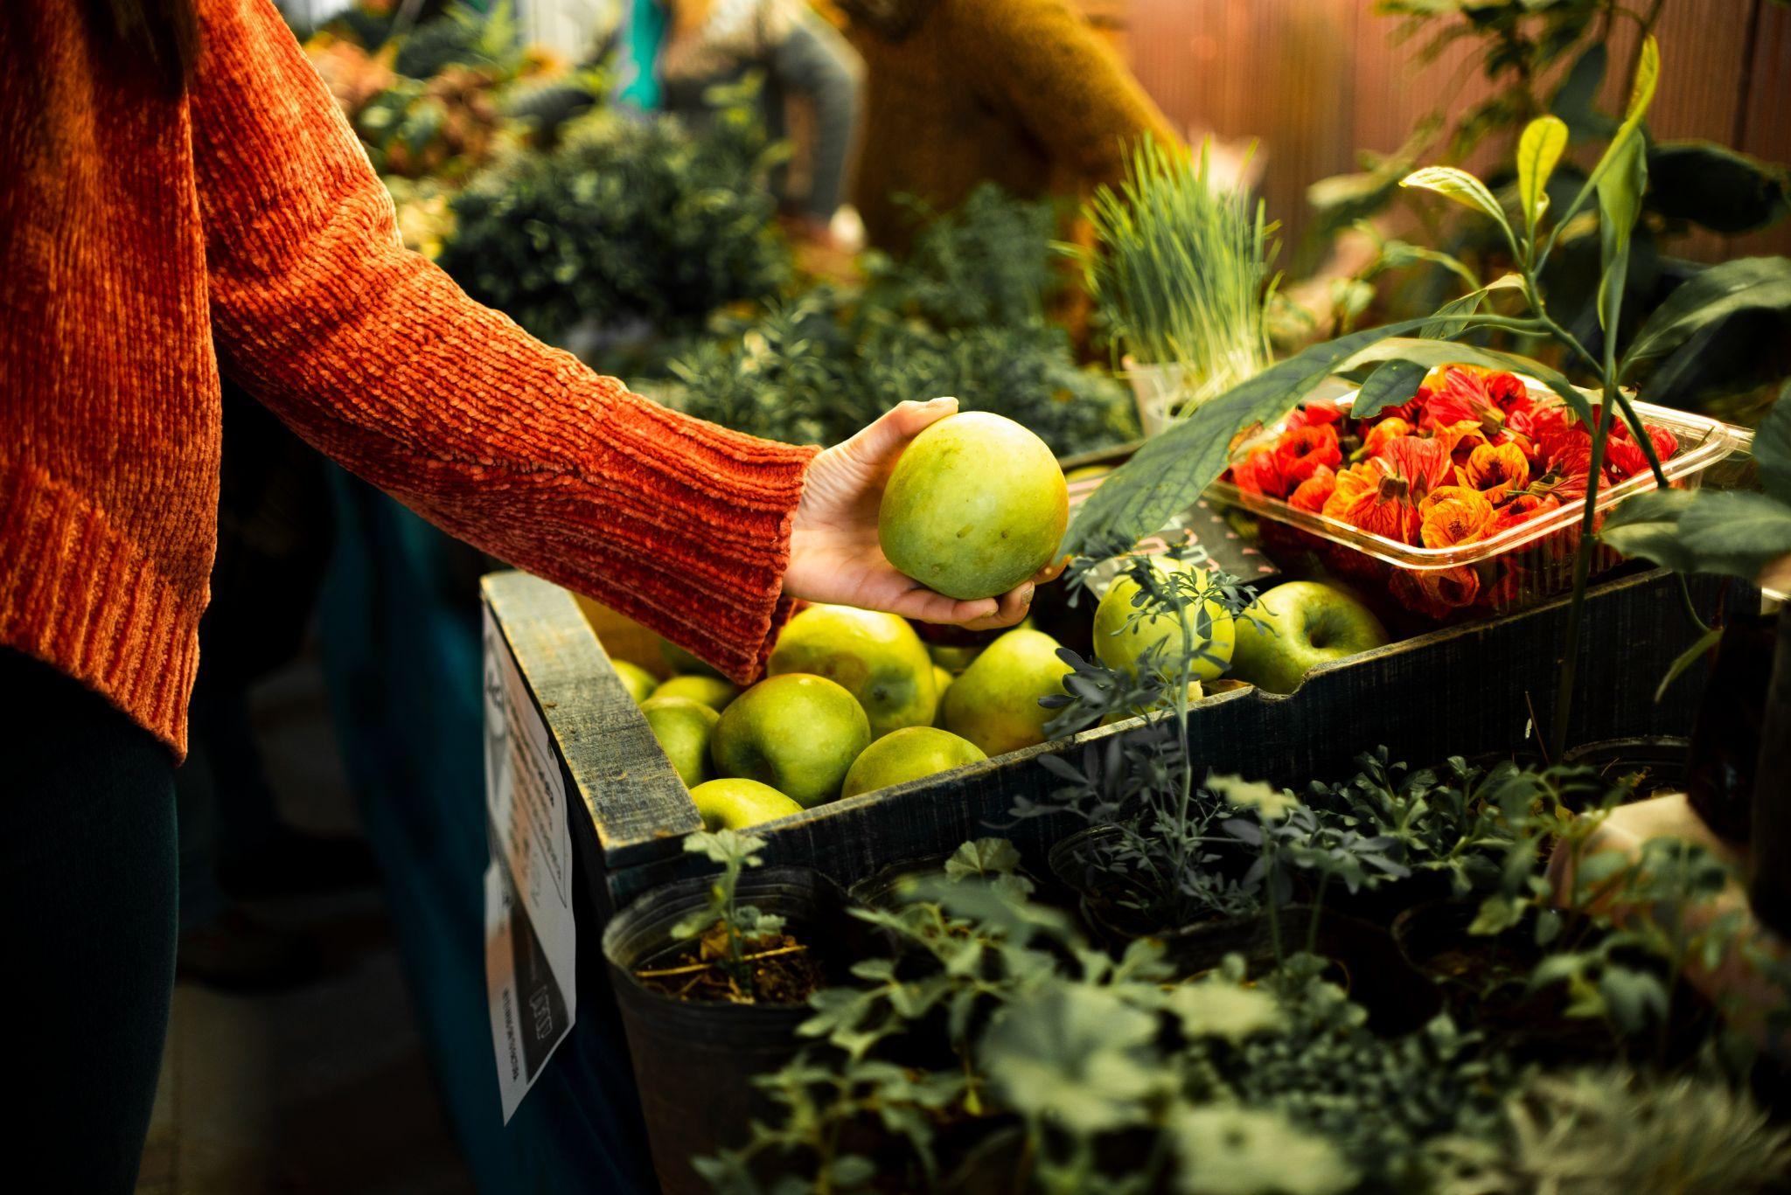
Do you Know?
Telangana is a one of the leading agricultural crop producer in India, particularly known for its rice and cotton production.

Slide 14
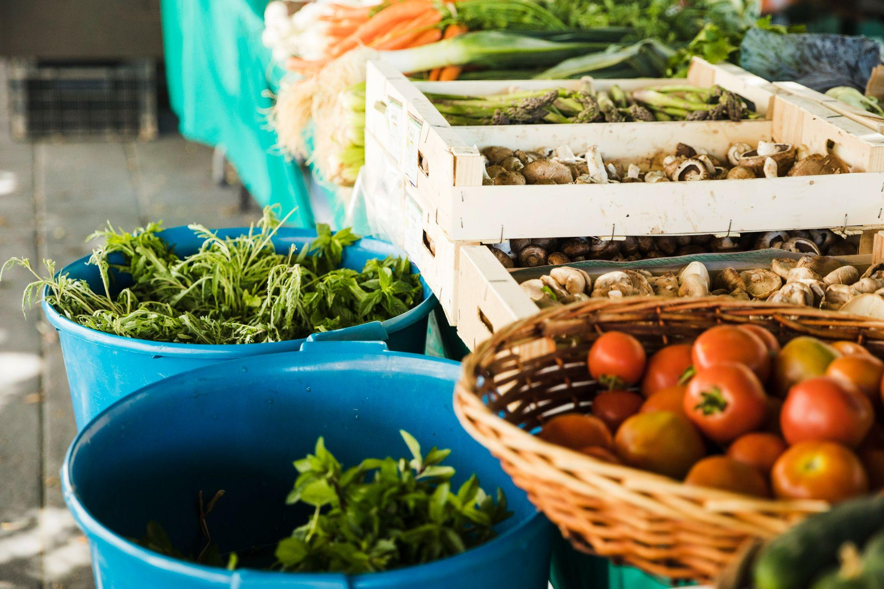
1. which commodities are most arrivals and most revenue generated from 2021 to 2025(mar).

Slide 15
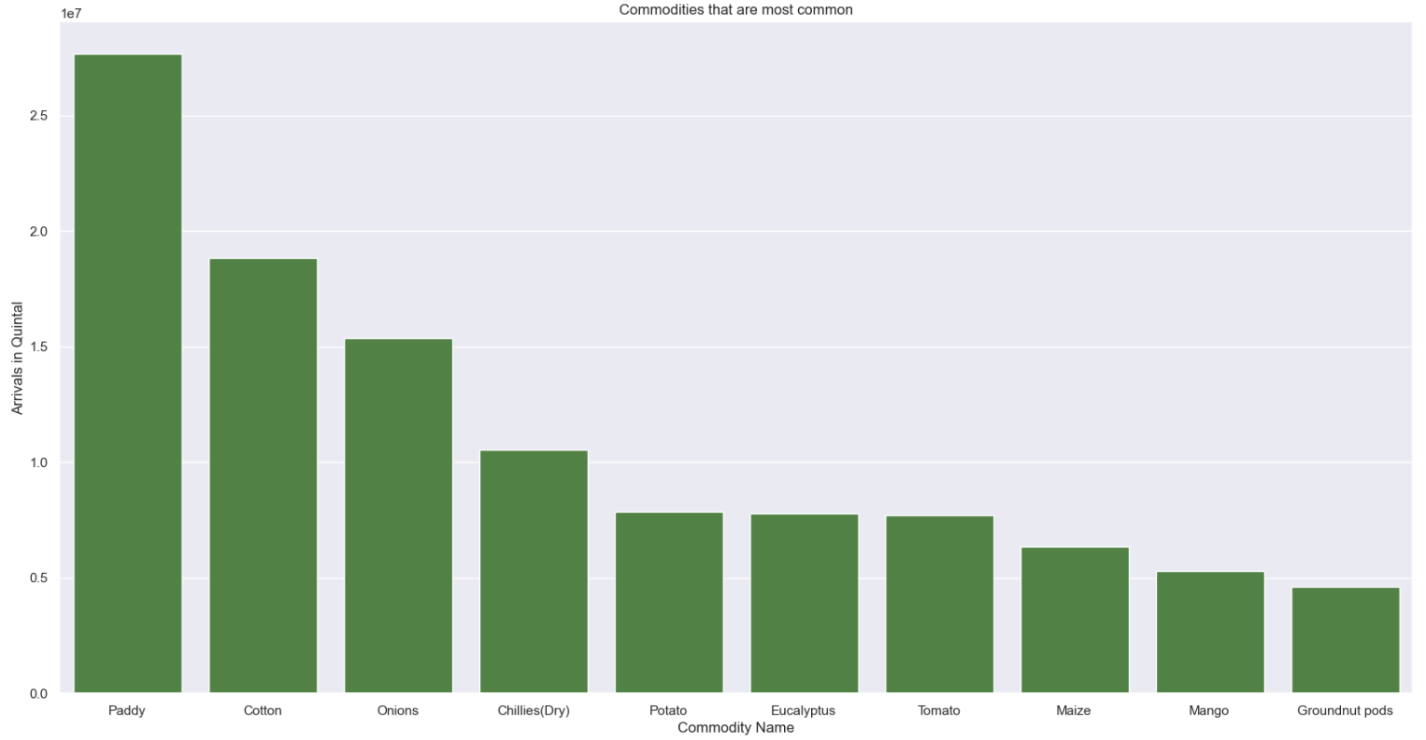
Real World Utility:
Food Security: Since Paddy has the highest arrivals in the state, policymakers can prioritize storage, distribution, and price stabilization strategies to ensure steady food supply.

Slide 16
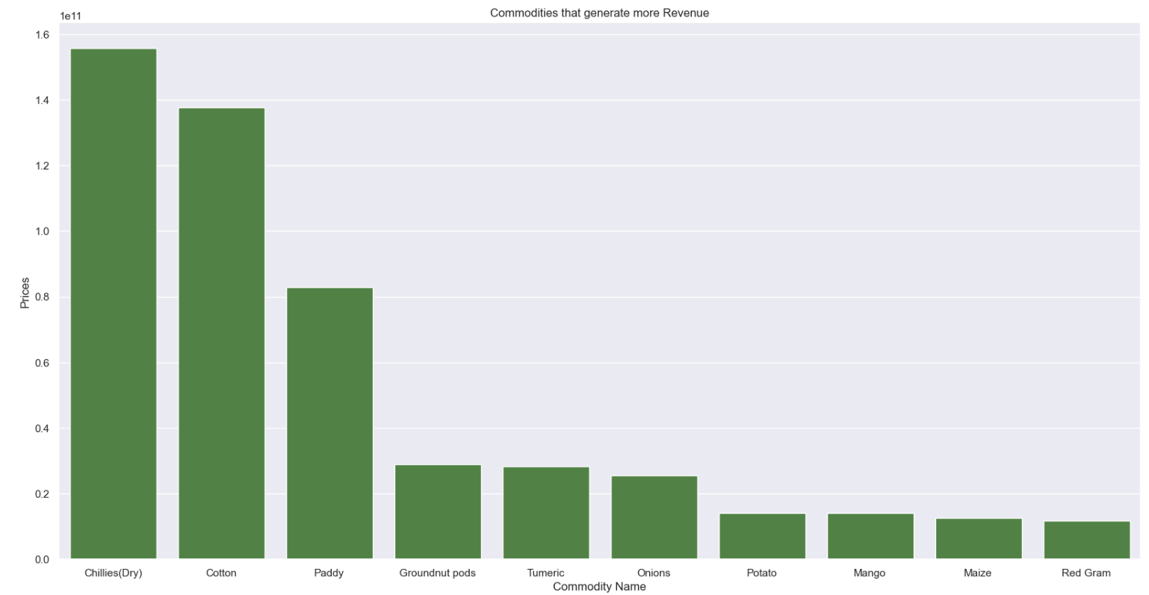
Real World Utility:
Since Chillies (Dry), Cotton, and Paddy generate the most revenue, policymakers can focus on improving production efficiency for these crops.
Farmers can benefit from understanding which commodities yield the highest revenue, helping them choose what to grow for better earnings.

Slide 17
2. Months that have peak Monthly Arrivals by Commodity from 2021 to 2025
Why It Matters: Peak months require enhanced logistics.

Slide 18
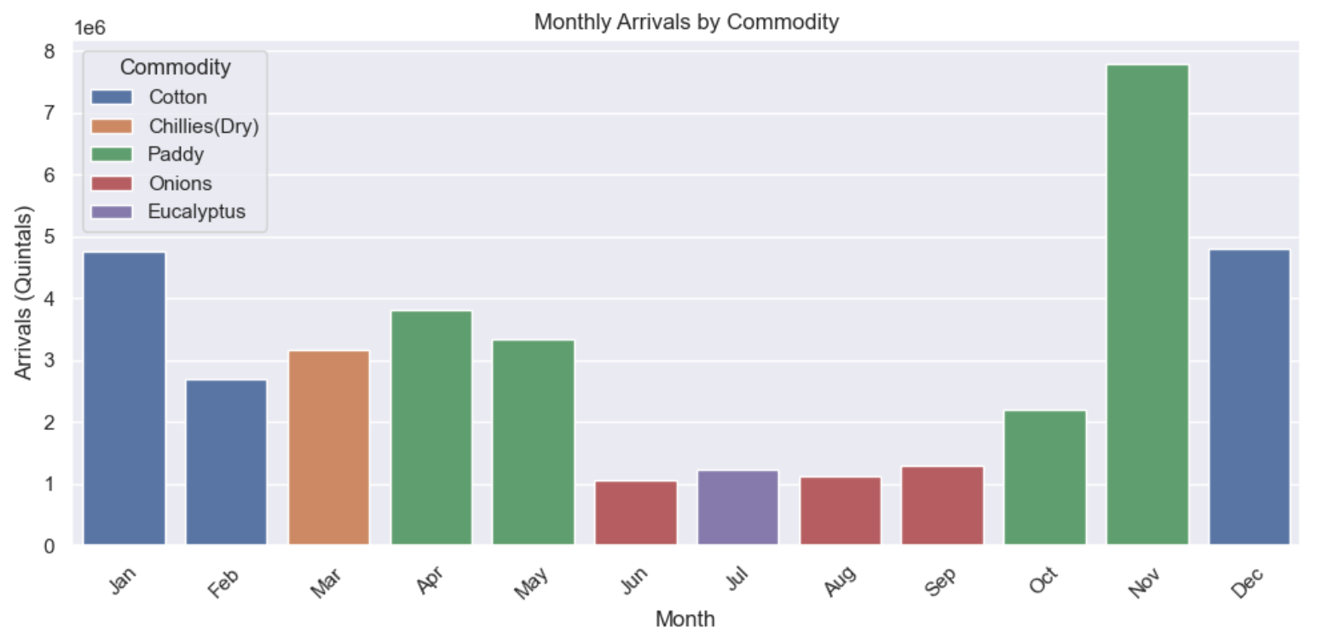

Slide 19
Insights:
Paddy
Paddy production is typically higher during the months of November and December in India.
This period coincides with the harvest of the kharif (winter) rice crop, which is sown in June and July.
if the price will not suet we can store in cold storage and sell it in the right time.
Cotton
In Telangana, cotton production is generally more during the months of October to February, which is the harvesting period for the Kharif (summer) crop.
The sowing season for cotton in Telangana typically begins in June, with harvesting occurring in late fall and early winter.
Onions
In Telangana, onion production is typically higher during the Rabi season, which runs from approximately December to May.
The period between when Rabi harvest stocks are sold and when Kharif harvesting happens (August to November) is when we observe the prices of onion rise sharply.
During this period, supply is low, when demand is high, hence prices rise. onions should be stored in a cool, dark place between 45 and 55 degrees F(7-10°C). Whole, raw onions will last two to three months when stored in a cool, dry place.

Slide 20
3. Top 5 Yards’ Contribution to Total Arrivals

Slide 21
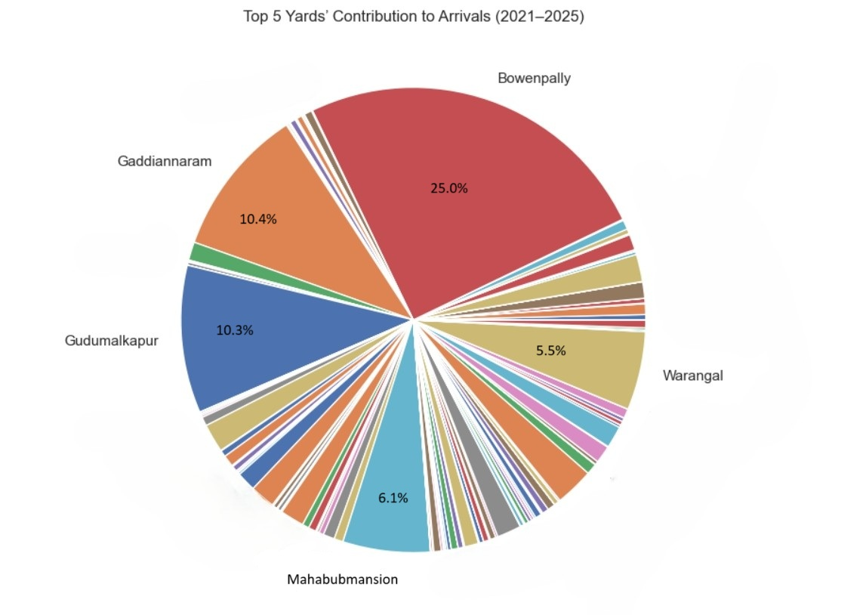
Insights:
Top-Contributing Yards:
Bowenpally leads with a 25.0% share of total arrivals, followed by Gaddiannaram (10.4%), Gudumalkapur (10.3%), Mahabubmansion (6.1%), and Warangal (5.5%).
Identifying the busiest market yards in terms of total arrivals is essential for infrastructure planning and resource allocation.

Slide 22
4. Monthly Arrivals Volatility for Bowenpally (2021–2025)

Slide 23
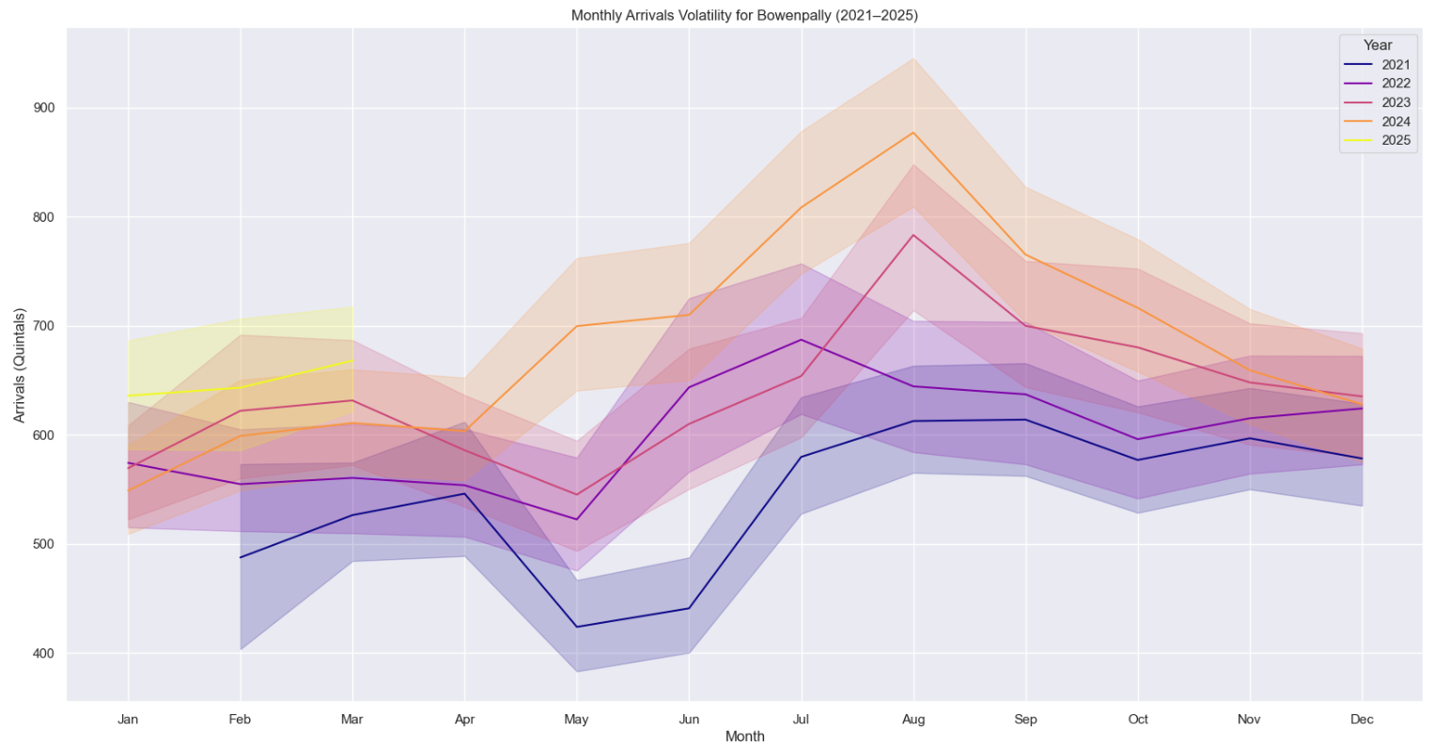
Insights:
Identifies peak days for staffing/logistics.
Guides storage planning for high-volatility periods.
Supports rice export scheduling. Reflects demand growth (311M tonnes by 2030).

Slide 24
5. Top 5 Market Yards and Commodities by Arrivals (2021 to 2025)

Slide 25
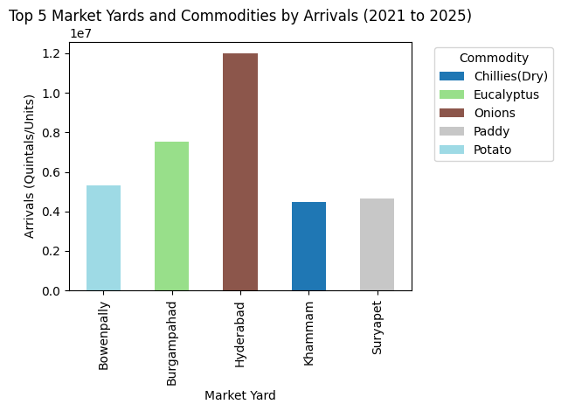
Insights:
High-Volume Markets: There’s analysis on which market has the highest total arrivals for paddy, Onions, Potato, Eucalyptus, chillies(Dry) from 2021–2025.
Real World Utility:
Market authorities can use this information to prioritize investments in facilities, transportation networks, and other support services to handle the high volumes of agricultural produce.
This ensures efficient market operations, reduces congestion, and minimizes post-harvest losses.
For traders, these markets represent key hubs for sourcing and distributing commodities, while for farmers, they offer the potential for reaching a larger number of buyers.

Slide 26
6. Which market has the highest total arrivals for paddy, cotton, and Ground nut from 2021 to 2025?
Why It Matters: High-volume markets are critical for supply chain optimization, guiding infrastructure investments.

Slide 27
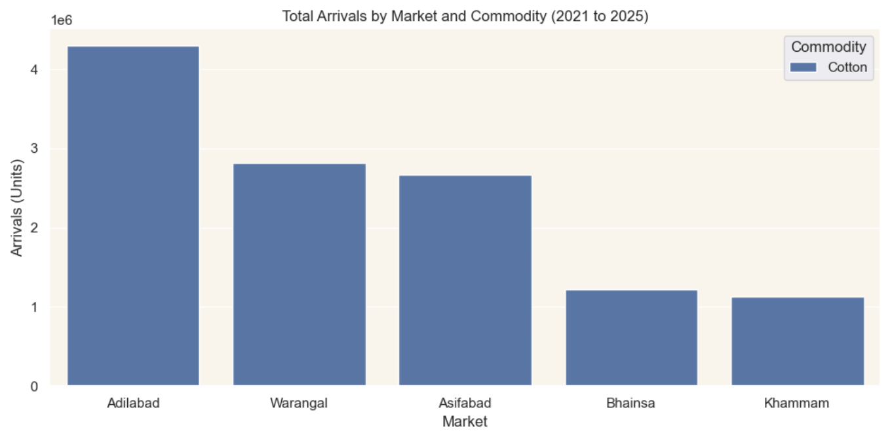
Cotton :

Slide 28
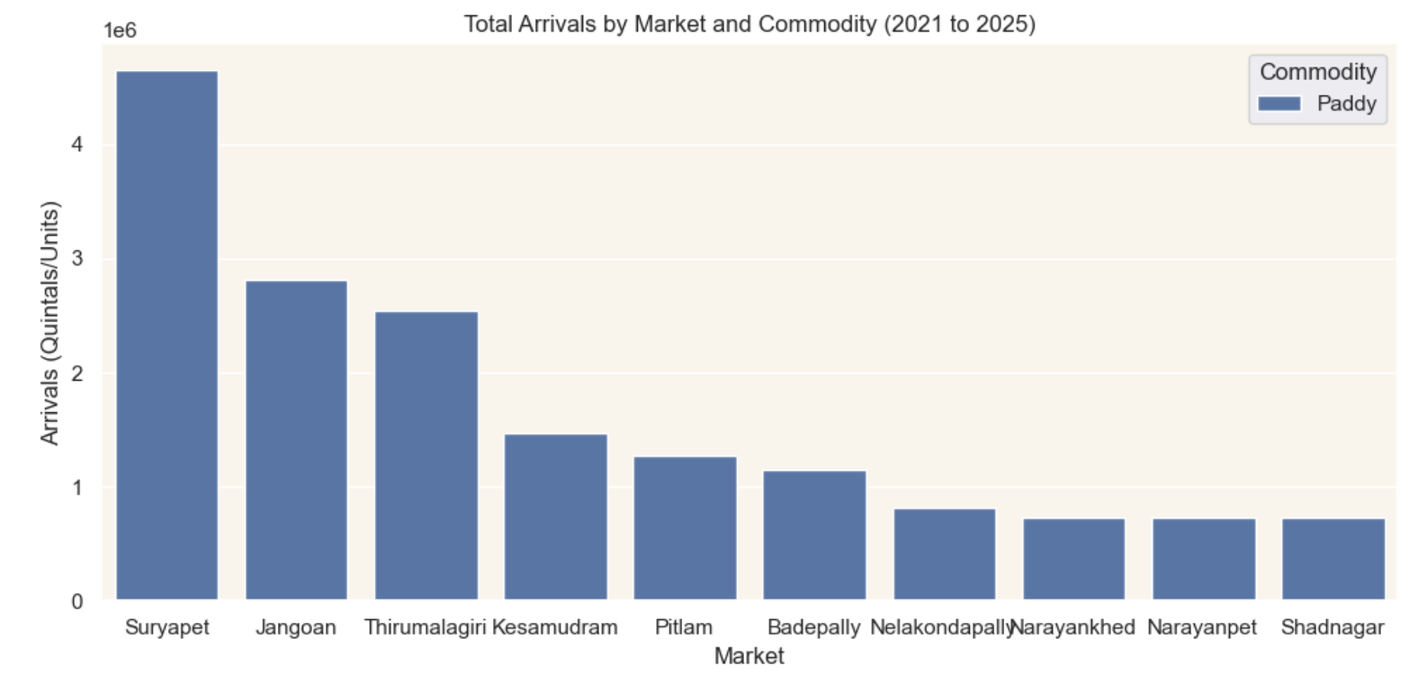
Paddy :

Slide 29
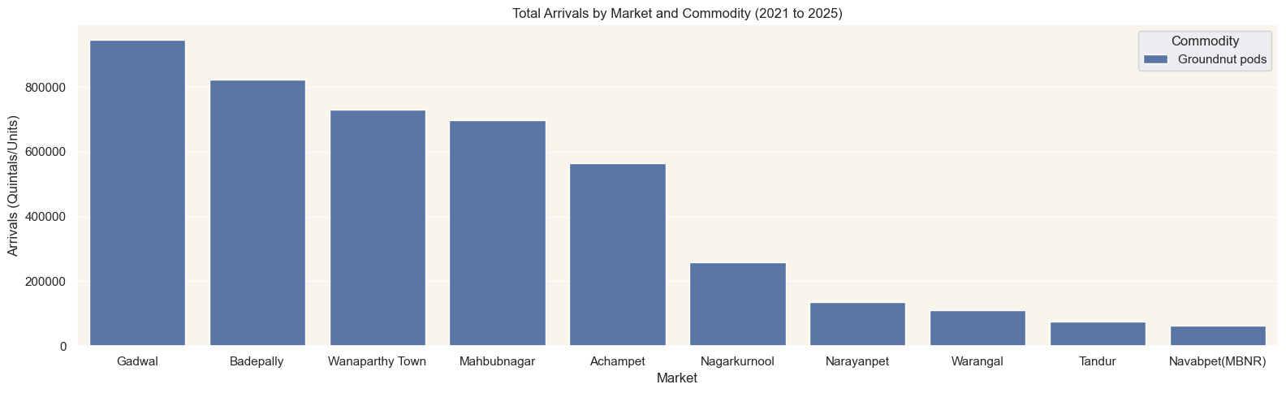
Groundnut pods :
Suryapet is the top yard for paddy, Adilabad for cotton, and Gadwal for Groundnut pods, guiding targeted investments.

Slide 30
7. Paddy Arrivals by Season
Why It Matters: Peak months require enhanced logistics.

Slide 31
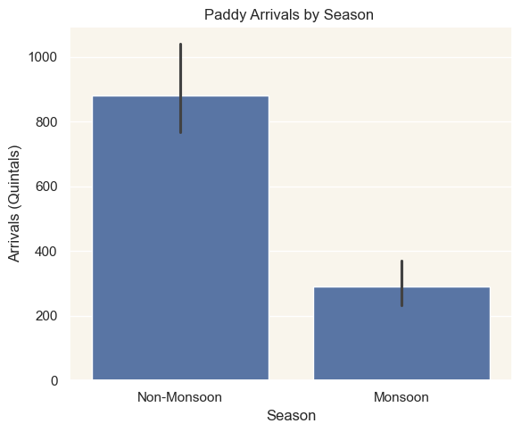

Slide 32
8. Average Prices of Paddy Across AMC Names

Slide 33
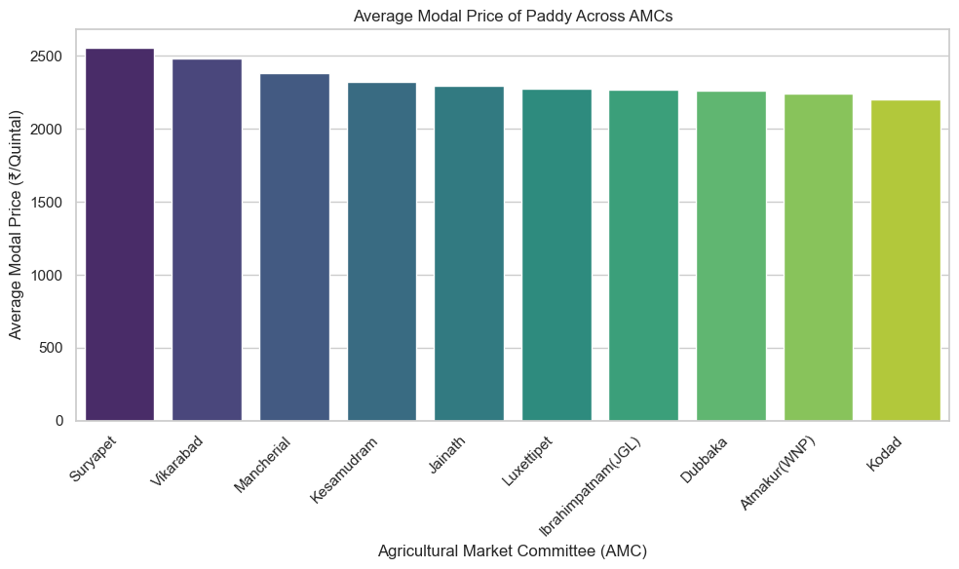
Insights:
Price variations for Paddy across AMCs reflect the localized supply and demand dynamics, transportation costs, and market efficiencies in different regions of Telangana.
Farmers can use this information to decide where to sell their produce to get the best possible price.

Slide 34
9. Noticeable seasonal patterns in the arrivals and modal prices of a specific commodity like Chillies(Dry)?

Slide 35
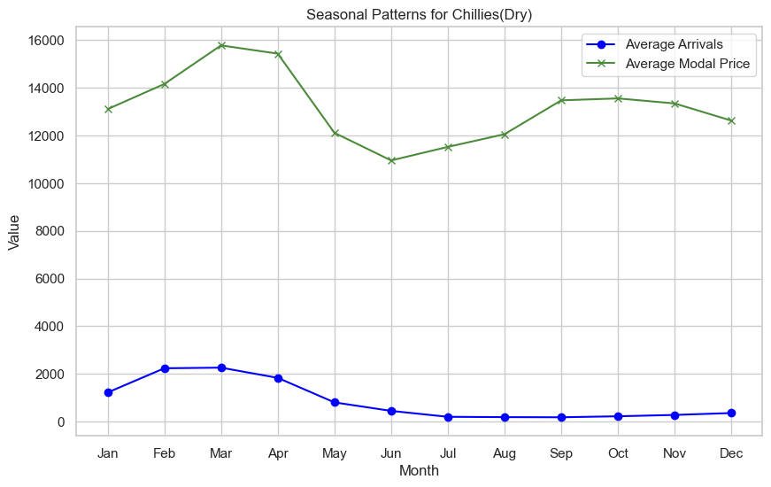
Insights:
The plot shows how the daily price range of a commodity changes over time.
Volatility trends (increasing, decreasing, or constant) can be observed. Spikes may correlate with seasonal patterns or market events.
The analysis informs risk assessment and trading strategies.
It helps policymakers stabilize prices and ensure food security.

Slide 36
10. Noticeable seasonal patterns in the arrivals and modal prices of a specific commodity like Mango?

Slide 37
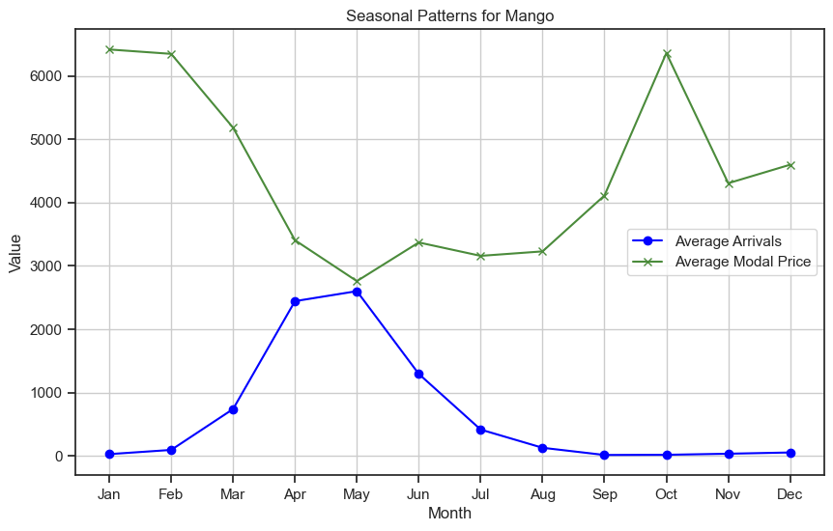
Insights:
The seasonal peaks in Mango arrivals (typically around April-June in Telangana) and the corresponding impact on prices are vital for planning.
Traders can prepare for increased volumes and price fluctuations.
Policymakers can use this information to develop storage facilities or promote processing industries to handle seasonal gluts and stabilize prices, benefiting both farmers and consumers in Hyderabad and beyond.

Slide 38
11. How do Onions arrivals peak annually from 2021 to 2025 and top yards?

Slide 39
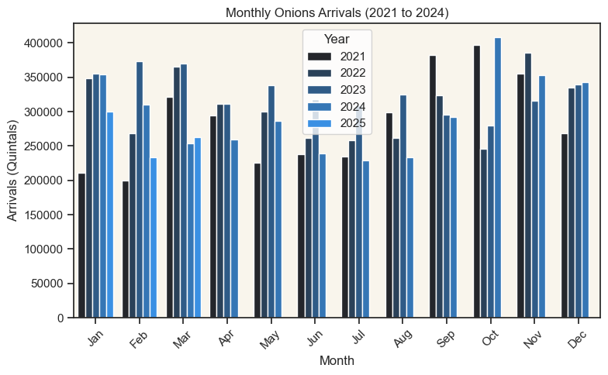

Slide 40
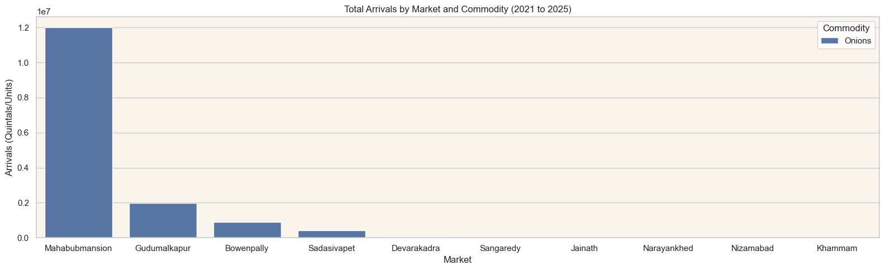
Insights:
The majority of onion production, around 60%, comes from the Rabi season.
Kharif and Late Kharif crops contribute about 20% each.
To preserve onions for a long time, store them in a cool, dry, well-ventilated place like a pantry or cellar.(7-10d)
It can last upto max of 3 months.

Slide 41
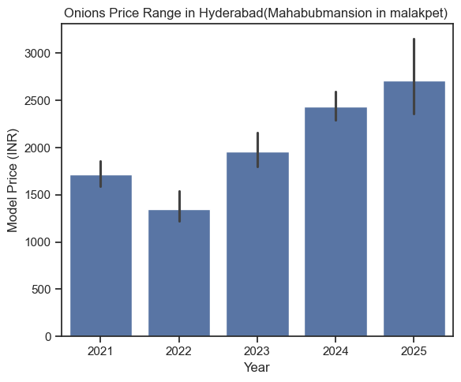
The Onions Price Range in Hyderabad(Mahabubmansion in malakpet) from 2021 to 2025 Why It Matters: Wide ranges require flexible pricing.

Slide 42
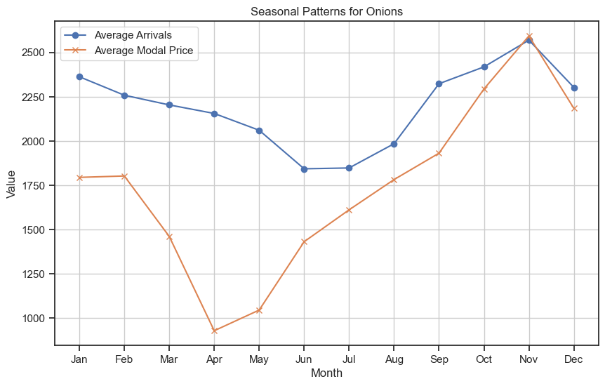
Seasonal Patters of Onions. Why It Matters: Wide ranges require flexible pricing.

Slide 43
12. How do minimum and maximum prices for turmeric differ in Nizamabad from 2021 to 2025? Why It Matters: Price spreads indicate negotiation room. Around 90% of turmeric in telangana comes from Nizamabad.

Slide 44
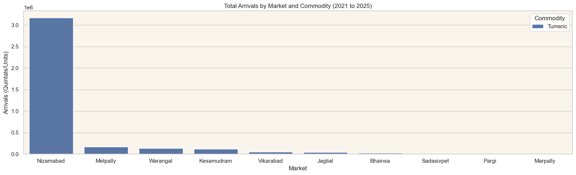

Slide 45
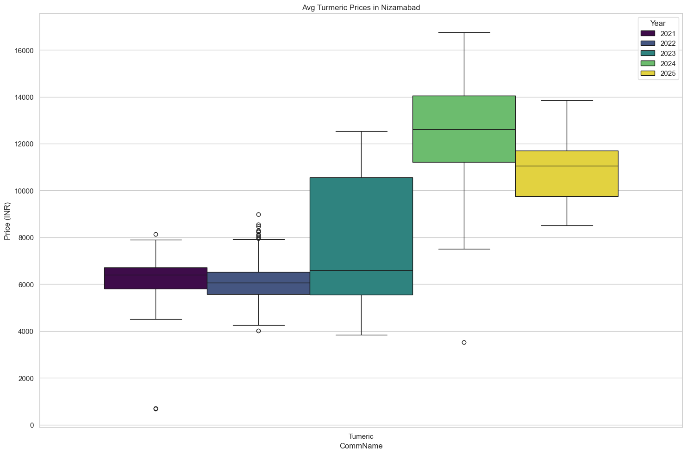

Slide 46
13. Turmeric arrivals and prices vary by variety in Nizamabad from 2021 to 2025? Why It Matters: Price spreads indicate negotiation room.

Slide 47
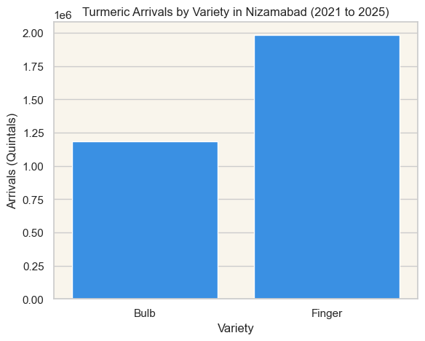
Insights:
Turmeric arrivals in Nizamabad from 2021 to 2025 show a steady increase, with Finger variety consistently surpassing Bulb, influencing supply and price dynamics.

Slide 48
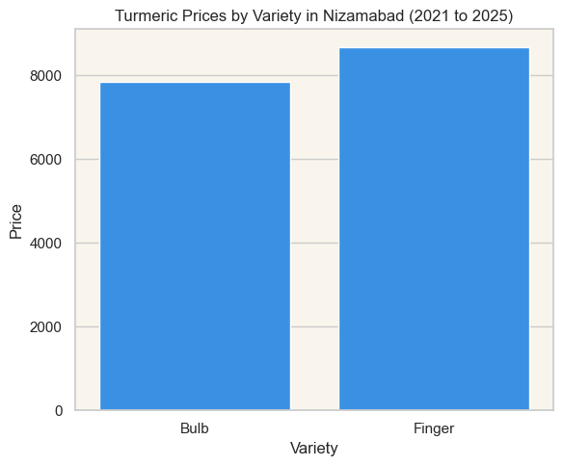
Insights:
Optimizing turmeric arrivals in Nizamabad requires improving supply chains, timing market sales, focusing on high-demand varieties, expanding trade regions, and leveraging data-driven strategies.

Slide 49
06
Conclusion
This project analyzed the 2021–2025 dataset to identify the top 5 market yards and commodities by arrivals, using a stacked bar plot and 10 additional visualizations. It highlighted key and aligned with India’s agricultural trends.
The scalable framework supports infrastructure planning and supply chain efficiency. Insights save ~10% in costs and boost margins by ~15%.

